Slide 1
A Breakthrough in Nuclear Cardiac Imaging
Mahrukh Syed, BSc

Slide 2
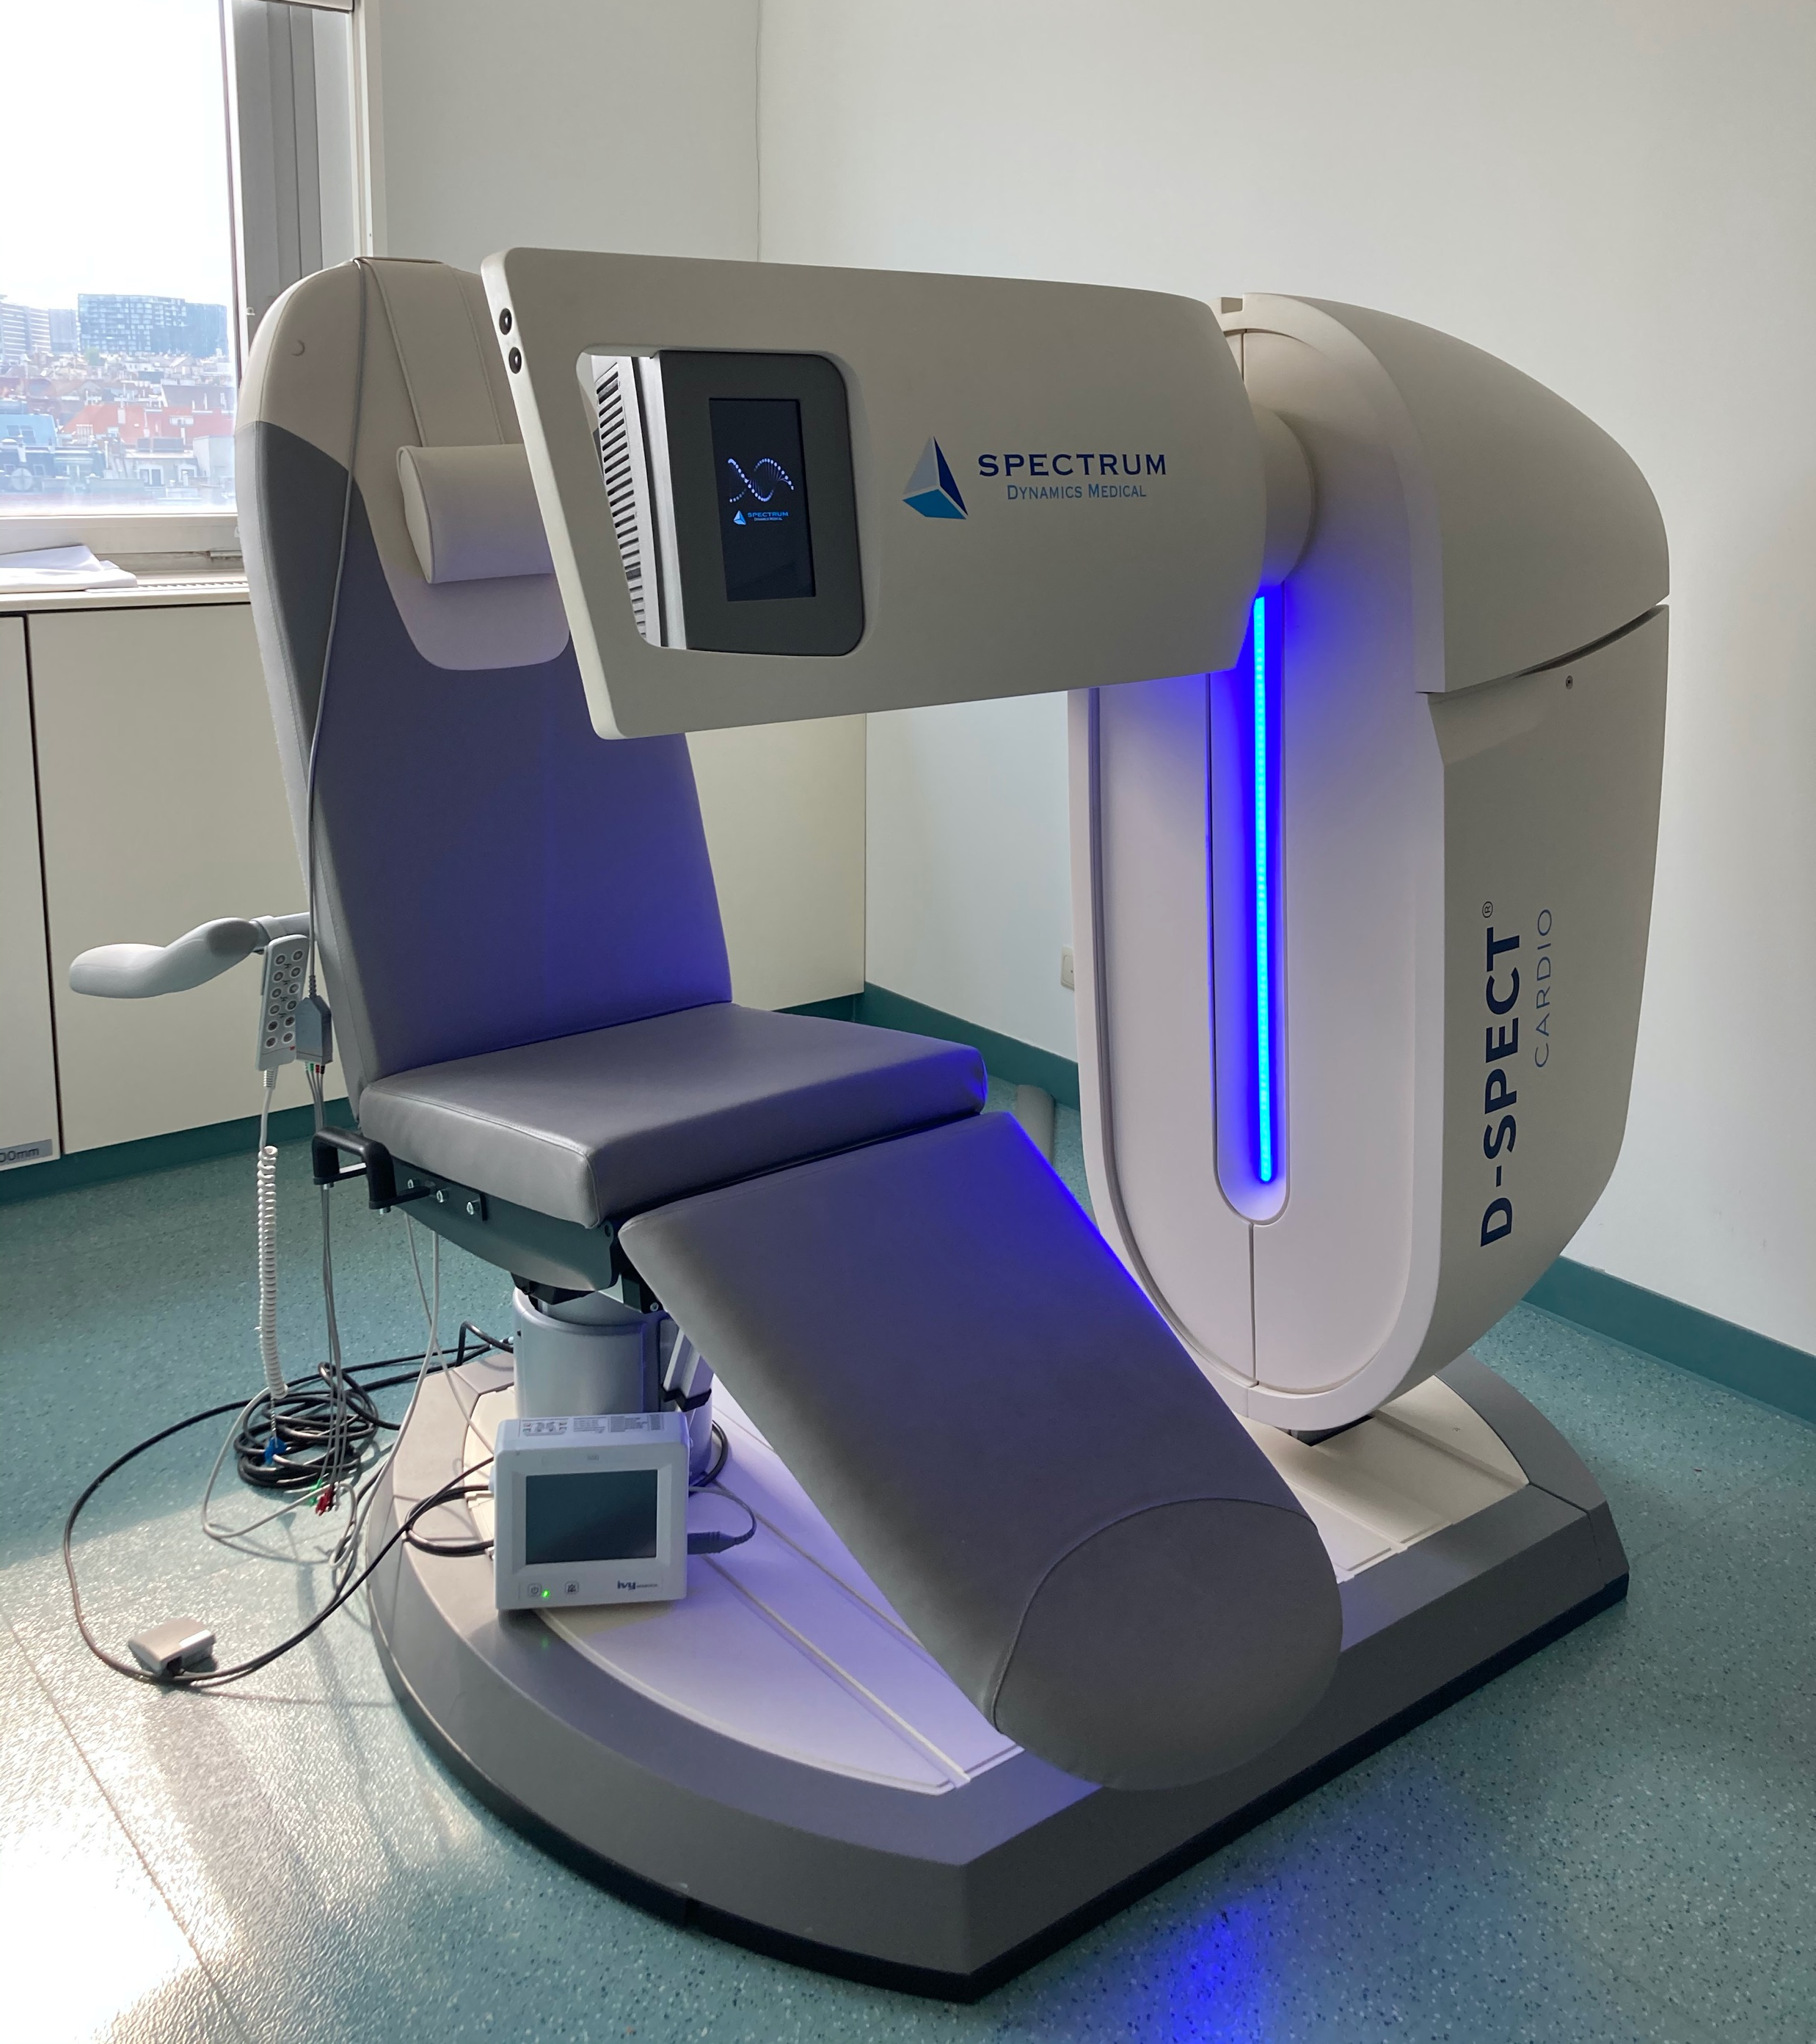
D-SPECT
Picture by Mahrukh Syed, BSc
Vienna's first highly sensitive cardiac SPECT camera
Spectrum Dynamics Medical
9 columns of Cadmium Zinc Telluride detectors
https://spectrum-dynamics.com/products/d-spect-series/

Slide 3
Advantages
High detector sensitivity → shorter scanning times
Imaging of even most challenging patients possible
No more claustrophobia → open design, no Ganrty motion
High flexibility → imaging in many positions possible
Time-saving → not many reconstructions
Space saving

Slide 4
Variable positioning options
https://spectrum-dynamics.com/products/d-spect-series/

Slide 5
Disadvantage
Sensitive → problem, if room temperature > 23°C
Heat → camera stops working

Slide 6
References
https://spectrum-dynamics.com/products/d-spect-series/
Klinik Landstraße – Institute for Nuclear Medicine, Vienna

